Slide 1


PANIMALAR ENGINEERING COLLEGE
DEPARTMENT OF COMPUTER SCIENCE AND ENGINEERING
CS8811 PROJECT WORK
FINAL PRESENTATION
Wheat leaf Disease Recognition using Tensorflow and Keras
Guide Name: Mrs. R SALINI, Assistant Professor
Aakash Karthikeyan -211418104001,
Abhishek Sundar R - 211418104005,
Akilnandhan A - 211418104014.
Batch No: E17

Slide 2
Introduction :-
Deep learning can be considered as a subset of machine learning. It is a field that is based on learning and improving on its own by examining computer algorithms. While machine learning uses simpler concepts, deep learning works with artificial neural networks, which are designed to imitate how humans think and learn.
A convolutional neural network (CNN/ConvNet) is a class of deep neural networks, most commonly applied to analyze visual imagery.
TensorFlow is a software library or framework, designed by the Google team to implement machine learning and deep learning concepts in the easiest manner. It combines the computational algebra of optimization techniques for easy calculation of many mathematical expressions.
Keras is a high level deep learning API written in python for neural networks. It supports multiple backend neural network computations and makes implementing neural network easy.

Slide 3
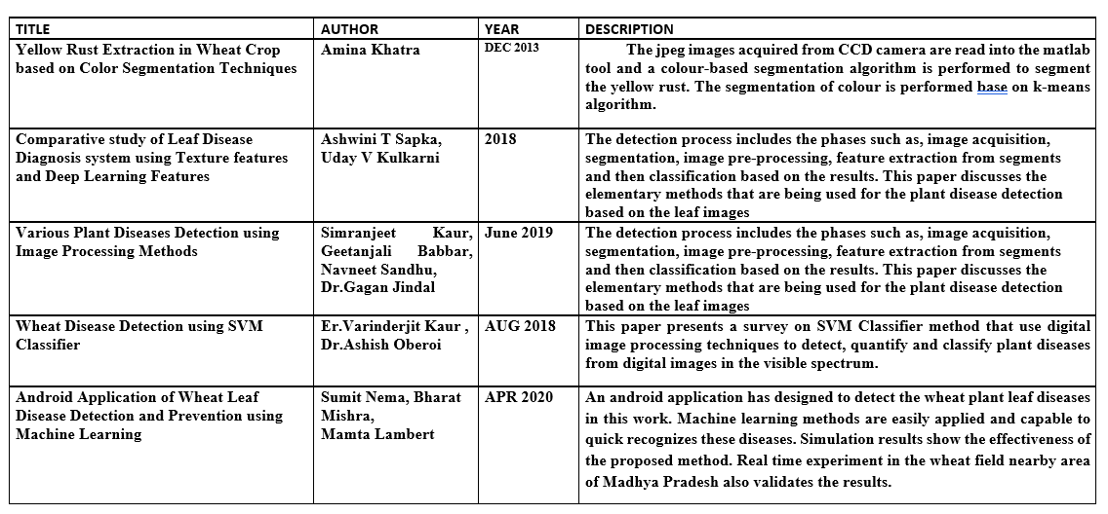
Literature Survey

Slide 4
Problem Statement
One of the important sectors of Indian Economy is Agriculture. Employment to almost 50% of the countries workforce is provided by Indian agriculture sector.
India is known to be the world's largest producer of pulses, rice, wheat, spices and spice products. Farmer's economic growth depends on the quality of the products that they produce, which relies on the plant's growth and the yield they get. Therefore, in field of agriculture, detection of disease in plants plays an instrumental role.
Plants are highly prone to diseases that affect the growth of the plant which in turn affects the ecology of the farmer. In order to detect a plant disease at very initial stage, use of automatic disease detection technique is advantageous.
The symptoms of plant diseases are conspicuous in different parts of a plant such as leaves, etc. Manual detection of plant disease using leaf images is a tedious job. Hence, it is required to develop computational methods which will make the process of disease detection and classification using leaf images automatic.

Slide 5
Development Environment
Software Requirements:
Operating System : Windows
Simulation Tool : Anaconda with Jupyter Notebook
Hardware requirements:
Processor : Pentium IV/III
Hard disk : Minimum 300 GB
RAM : Minimum 4 GB

Slide 6
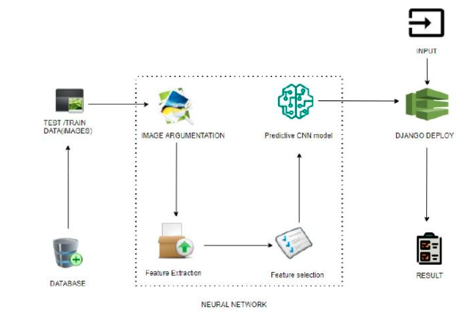
System Architecture:-

Slide 7
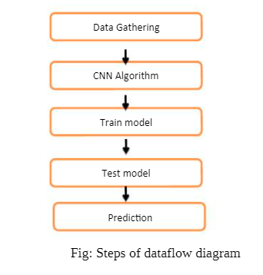
System Design

Slide 8
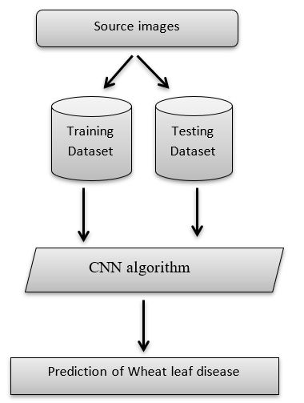
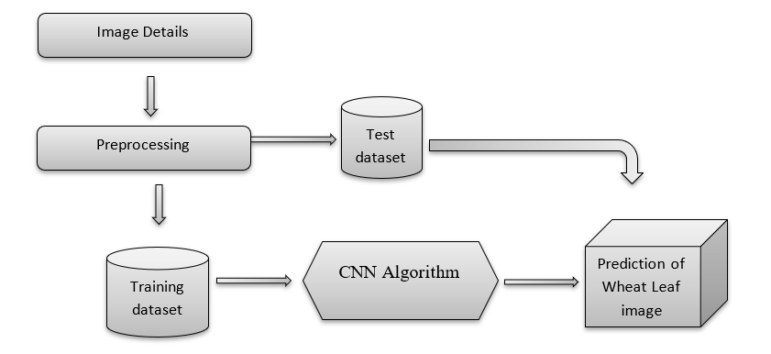
System Design - WorkFlow Diagram / Data Flow Diagram (DFD)
Data Flow Diagram
WorkFlow Diagram

Slide 9
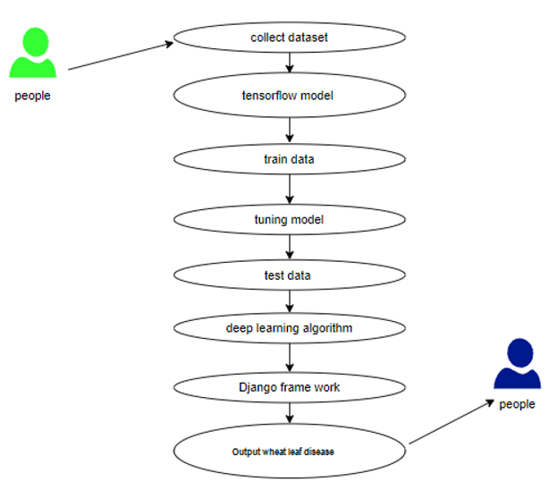
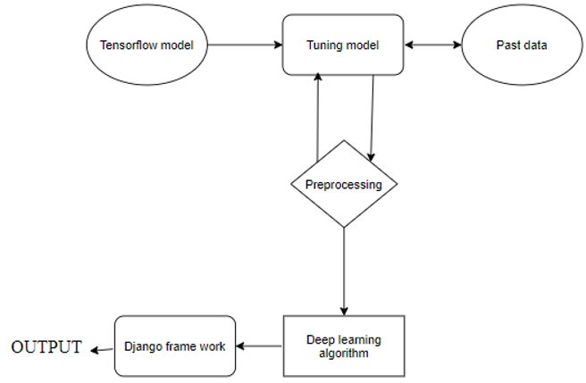
System Design - ER Diagram / Use Case Diagram
ER Diagram
Use case Diagram

Slide 10
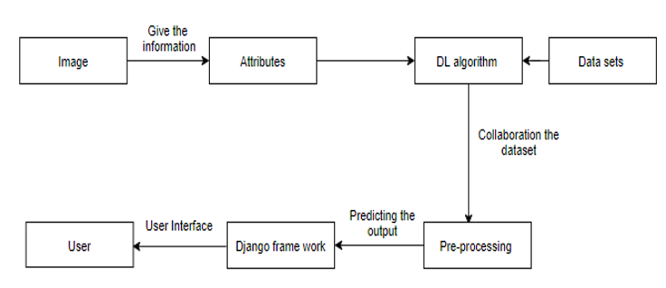
System Design - Collaboration Diagram

Slide 11
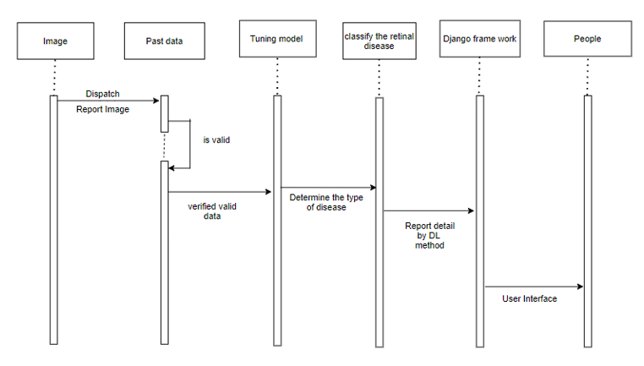
System Design - Sequence Diagram

Slide 12
Module Description
1. Manual Net
List of Modules :
ManualNet
AlexNet
LeNet
Deploy
Import the given image from dataset
To train the module by given image dataset
Working process of layers in CNN model

Slide 13
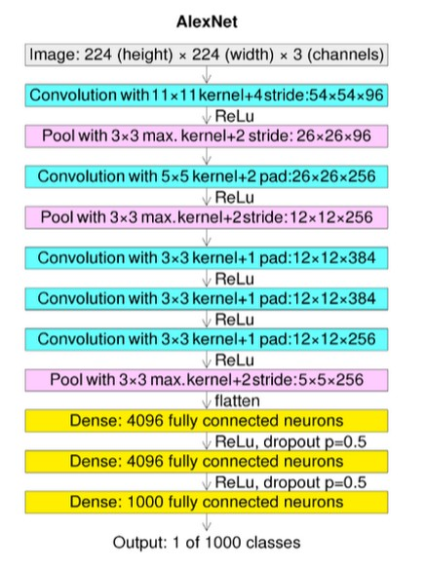
2. AlexNet:
AlexNet architecture consists of 5 convolutional layers, 3 max-pooling layers, 2 normalization layers, 2 fully connected layers, and 1 softmax layer.
Each convolutional layer consists of convolutional filters and a nonlinear activation function ReLU.

Slide 14
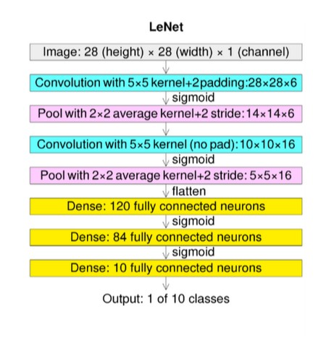
3.LeNet:
LeNet-5 CNN architecture is made up of 7 layers.
The layer composition consists of 3 convolutional layers, 2 subsampling layers and 2 fully connected layers.

Slide 15
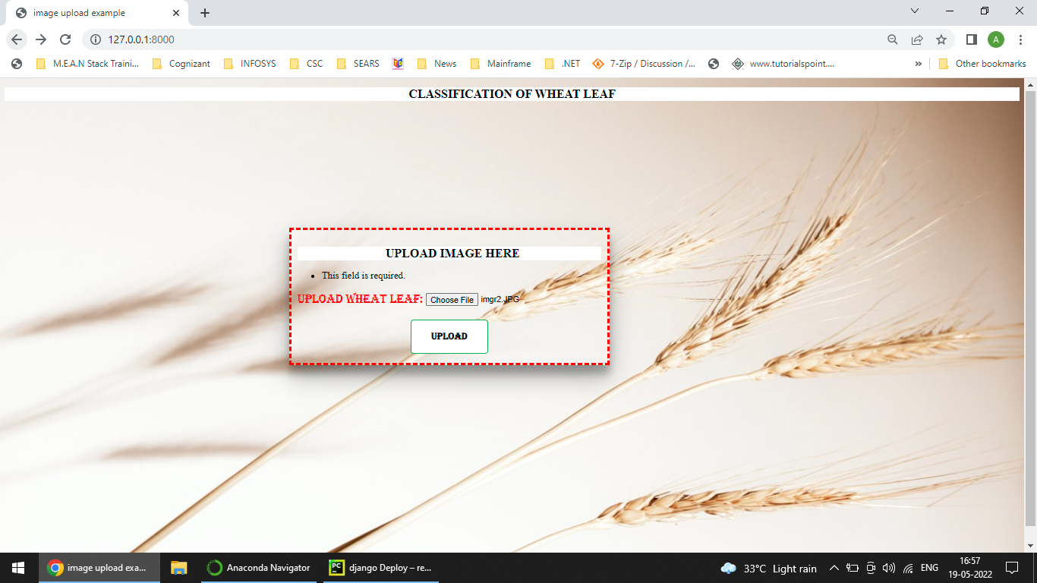
4. Deploy
In this module the trained deep learning model is converted into hierarchical data format file (.h5 file) which is then deployed in our django framework for providing better user interface and predicting the output whether the given OCT image is CNV / DME / DRUSEN / NORMAL.

Slide 16
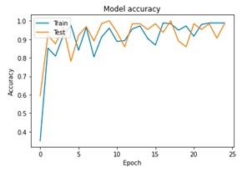
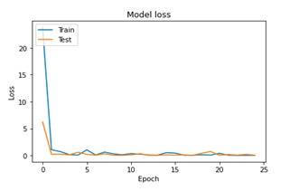
Performance Evaluation / Results
ManualNet

Slide 17
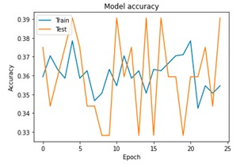
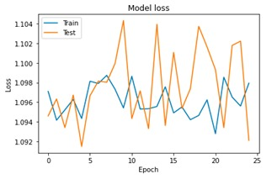
Performance Evaluation / Results
AlexNet

Slide 18
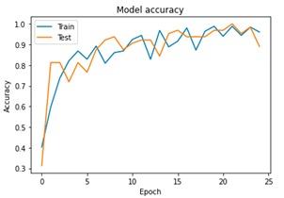
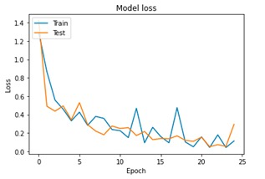
Performance Evaluation / Results
LeNet

Slide 19
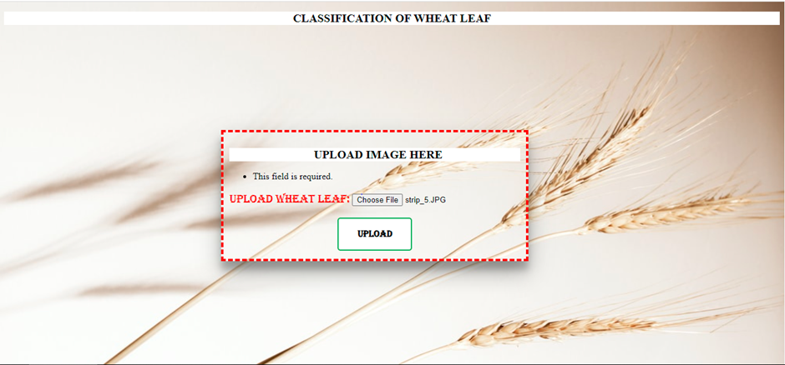
Screen Shots

Slide 20
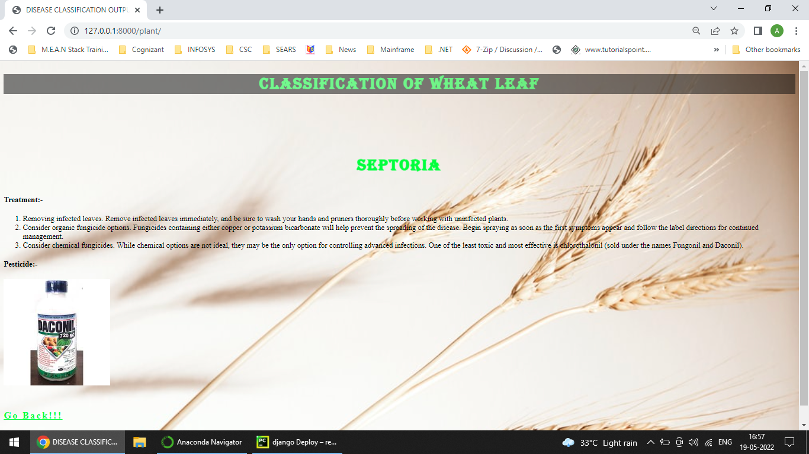

Slide 21
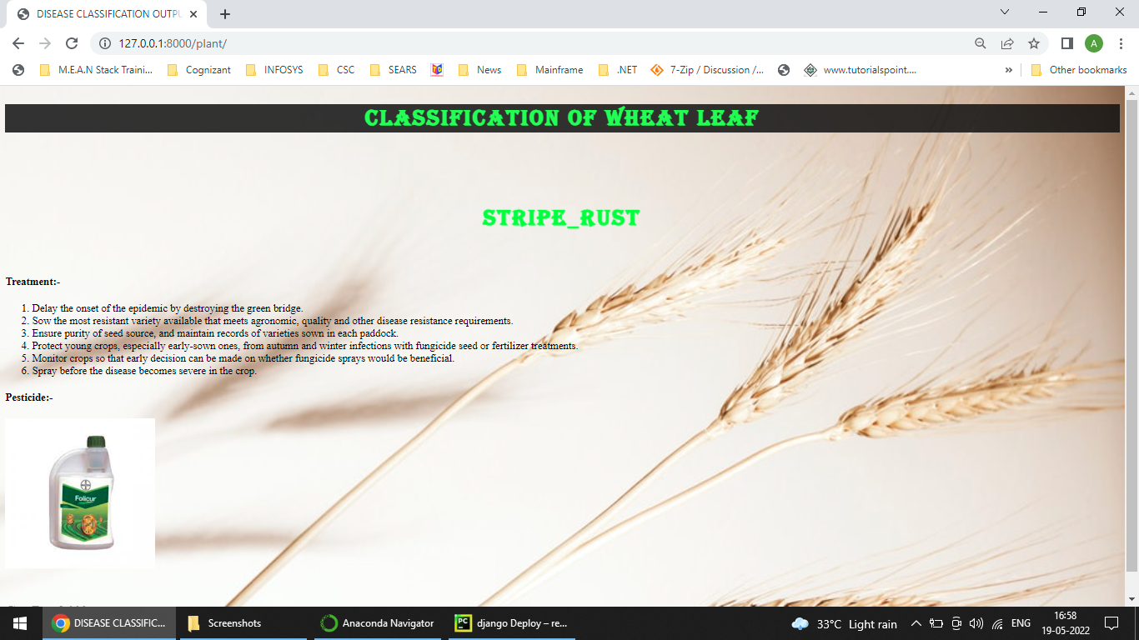

Slide 22
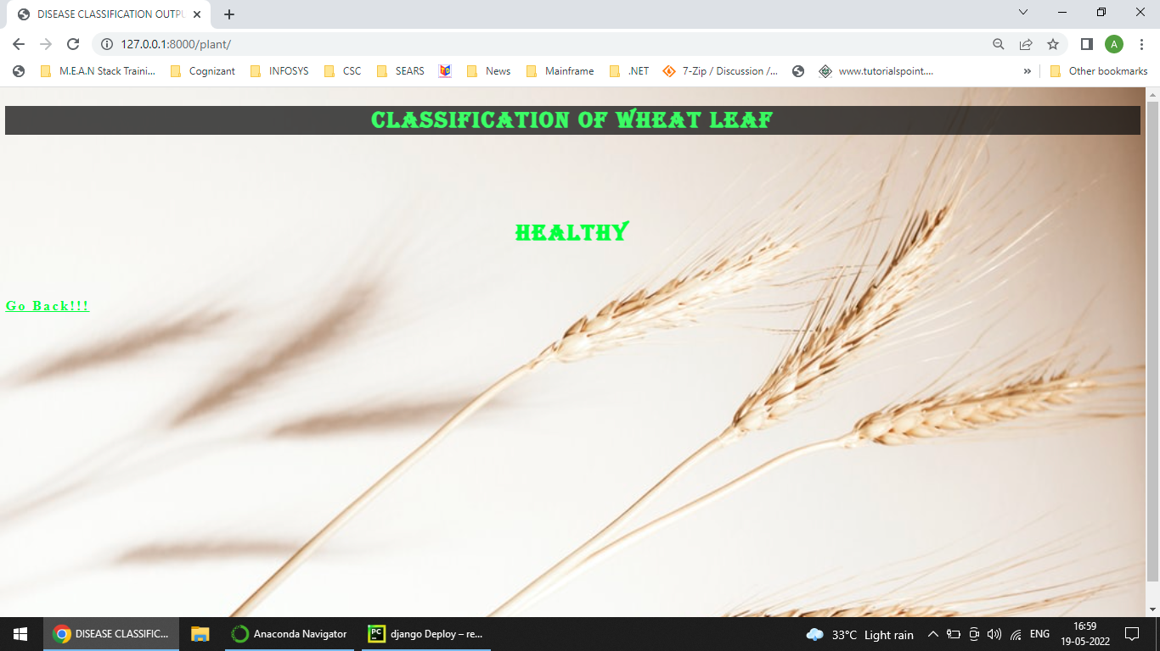

Slide 23
Conclusion
In this project, a research to classify Wheat leaf Disease Classification over static facial images using deep learning techniques was developed.
This is a complex problem that has already been approached several times with different techniques.
While good results have been achieved using feature engineering, this project focused on feature learning, which is one of DL promises.
While feature engineering is not necessary, image pre-processing boosts classification accuracy.
Hence, it reduces noise on the input data. Nowadays, Agriculture based AI wheat leaf disease includes is heavily required.
The solution totally based on feature learning does not seem close yet because of a major limitation. Thus, leaf Disease classification could be achieved by means of deep learning techniques.

Slide 24
References
[1] Amina Khatra, “Yellow Rust Extraction in Wheat Crop based on Color Segmentation Techniques IOSR Journal of Engineering, vol. 3, PP 56-58, December 2013.
[2] Sumit Nema, Bharat Mishra and Mamta Lambert “Android Application of Wheat Leaf Disease Detection and Prevention using Machine Learning”, International Journal of Trend in Research and Development., vol. 7(2), April 2020, ISSN: 2394-9333.
[3] Er.Varinderjit Kaur and Dr.Ashish Oberoi, “Wheat Disease Detection Using SVM Classifier,” JETIR, August 2018, Volume 5, Issue 8, ISSN-2349-5162.
[4] Simranjeet Kaur, Geetanjali Babbar, Navneet Sandhu and Dr. Gagan Jindal,” Various Plant Diseases Detection Using Image Processing Methods,” IJSDR, June 2019, Volume 4, Issue 6, ISSN: 2455-2631.

Slide 25
Thank you!

